Slide 1
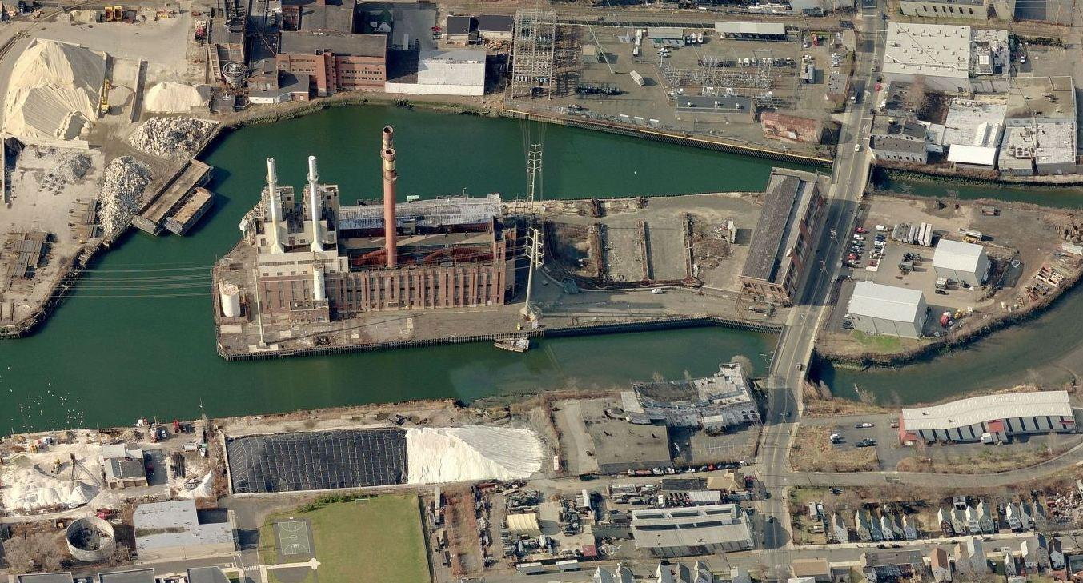

English Station Update Meeting
November 19, 2019

Slide 2
Agenda
Background and History
Project Milestones
  Completed
  Current
  Planned
Site Safety Precautions
  Building Abatement
  Site Remediation
Next Steps
Keeping You Informed

Slide 3
Background
The English Station Site is approximately 8.9 acres
The Site is comprised of two (2) Parcels referred to as:
- Parcel A: The parcel fronting Grand Ave where Station B formerly stood.
- Parcel B: The parcel on which the English Station building is located.
Background

Slide 4
Background
Station B
(Parcel A)
English Station
(Parcel B)
North
Grand Ave

Slide 5
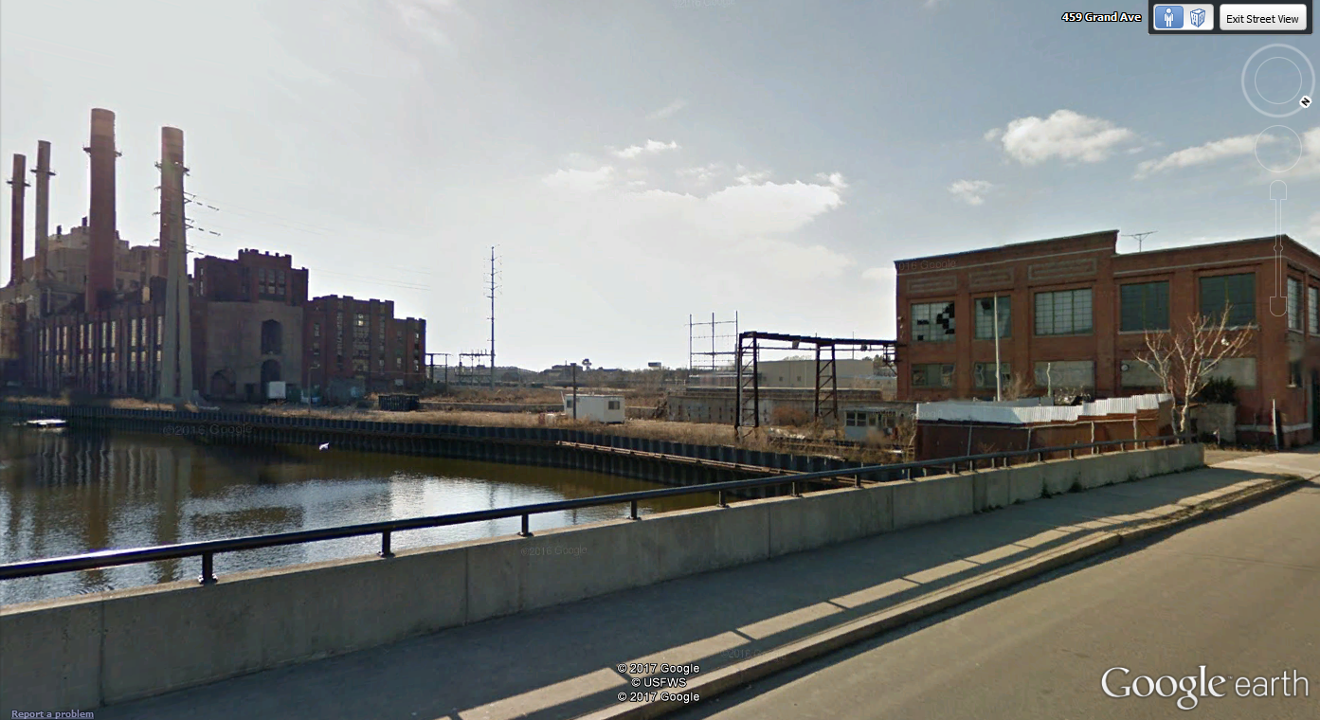
Background (September 2018)
English Station
Station B
Grand Ave

Slide 6
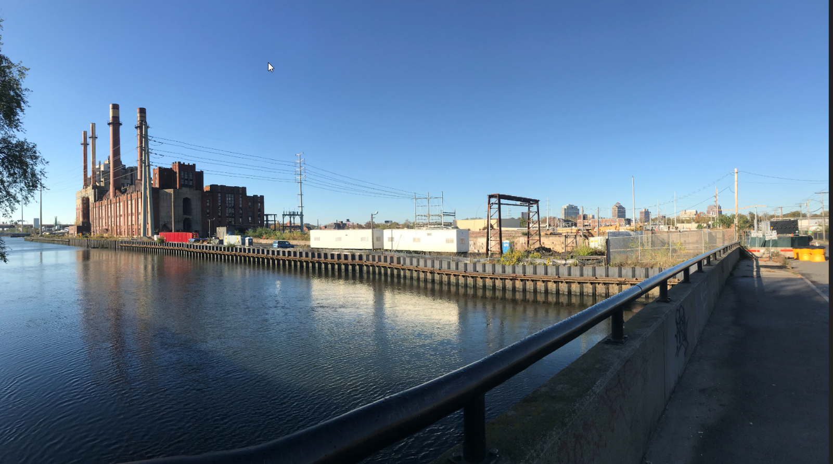
Background (October 2019)
English Station
Previous Location of Station B
Grand Ave

Slide 7
History
2000 – CT Department of Public Utility Control approves sale of English Station property by UI to Quinnipiac Energy (QE); QE intends to operate a generation facility at the site. QE assumed environmental liability for the site
2006 – QE unable to obtain approvals for the generation facility, so subdivides and sells Property:
- 5.3 acre English Station Parcel (Parcel B) sold to ASNAT Realty, and
- 3.6 acre Station B parcel (Parcel A) sold to Evergreen Power
2012– CT DEEP issues cease and desist order which finds that ASNAT and Evergreen had allowed work to be conducted on the Site that disturbed the hazardous conditions at the Site which caused PCB and other pollution to spread throughout the Site.
2015 – UI agrees to investigate and remediate the on-site conditions under a Partial Consent Order (PCO)
2016 – UI begins on-site investigation
2018 –Haven River Properties purchases Parcel A from Pacific & Atlantic LLC, and Paramount View Millennium LLC purchases Parcel B from Pacific & Atlantic LLC, both through foreclosure
Public Meetings
June 2017
March 2019
November 2019
History of the Site

Slide 8
Remediation Requirements
Under the Partial Consent Order, UI agreed to investigate and remediate the environmental conditions of the Site, including Soil, Groundwater and Buildings
  PCBs found in soil and building materials
  Asbestos found in buildings
  Various industrial impacts
Under the PCO, UI will remediate the soil at the Site to a minimum of the industrial/commercial standard
Remediation Standards are established by State and Federal Law and Regulations.
UI was granted access to the Site in August 2016 and has worked closely with the City of New Haven and with CT-DEEP in performing its investigation and remediation obligations under the PCO
Perform 24-hour per day, 365 days per year site-wide security

Slide 9
Project Status
Since 2016, the following activities have been performed and are on-going:
  Removal of asbestos-containing materials (ACM) from inside English Station, Station B and smaller on-site Auxiliary buildings
  Remediation of PCB-impacted concrete inside of Station B
  Investigations Conducted or Performed to Date:
    Sampling of Station B Building materials - completed
    Sampling of Auxiliary Buildings/Structures - completed
    Sampling of Soil outside of Buildings – completed
    Sampling of Groundwater - ongoing
    Sampling of English Station building materials and sub-slab (floor) material - ongoing
  Demolition of Station B
  Removal of concrete floor surfaces
  Removal of 5 transformers (October 2019) from within English Station

Slide 10
Project Status (cont’d)
As part of the work completed in accordance with state and federal environmental laws and regulations:
  Regulated Waste Removal
    51,000 bags of asbestos waste
    69 truck loads of demo debris
    750 pounds of universal waste(s)
    19 trailers of steel sent for recycling
  Site Investigation
    ~11,000 soil samples over the course of all investigations
    ~1,400 concrete samples
    ~4,300 building material samples
    Sampled 33 groundwater wells five times over a 14-month period
  Work has been performed with 0 safety incidents

Slide 11
Next Steps
Remediation Activities
Soil and Structures
  Complete Station B demo and dispose of regulated wastes
  Remediate soils (via excavation, rendering soils inaccessible)
  Site restoration, including new site security fence along Grand Avenue
  Post-remediation groundwater monitoring
Assessment Activities
Groundwater
  Work with CT DEEP and (as necessary) perform supplemental assessment of groundwater and develop appropriate remediation plans
English Station Building
  Supplemental Investigation(s) of soil, standing water, and building materials
  Review and evaluate remediation alternatives and work with CT DEEP to determine appropriate remedial plan for the building

Slide 12
Community Safety
Safety and environmental control regulations.
Traffic control measures.
Dust emissions monitoring and mitigation.
Erosion control measures.
Proper management, handling, storage and disposal of contaminated materials.
Equipment decontamination.

Slide 13
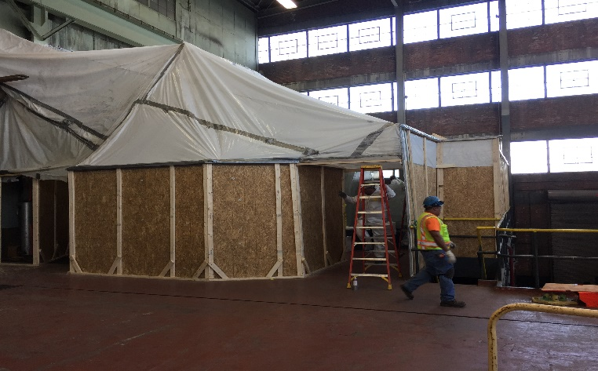
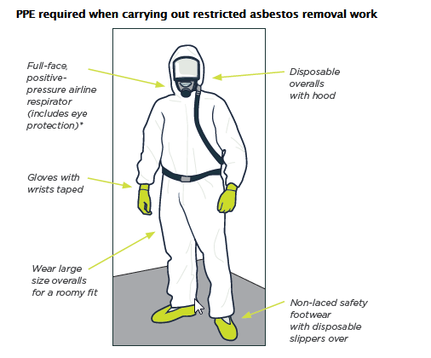
Typical Building Abatement Environmental Safety Precautions (Past and Future)
Work Performed in sealed poly containments established to completely enclose work area
Poly containment work areas under continuous negative air pressure with discharged air going through high-efficiency particulate air (HEPA) filters to prevent airborne releases
Air sampled outside containments
Wastes from the work placed in sealed double bags/boxes before leaving containment and placed in secure trailers
All materials and personnel leaving containment decontaminated
Wash water collected and disposed of properly
Licensed asbestos monitors provide ongoing evaluation of work areas as well as means and methods to ensure against contaminant release

Slide 14
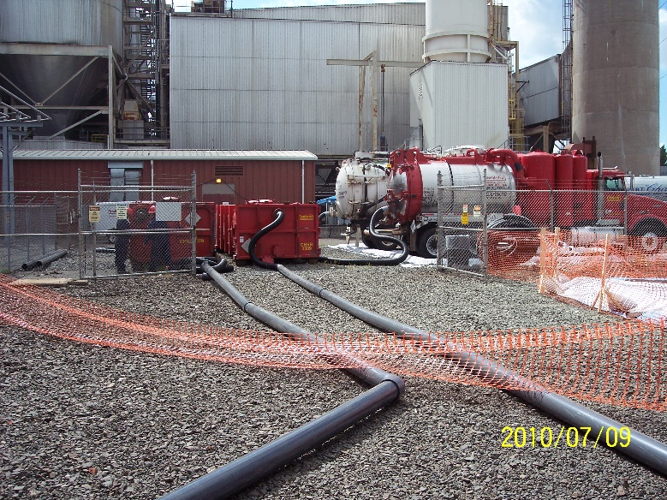
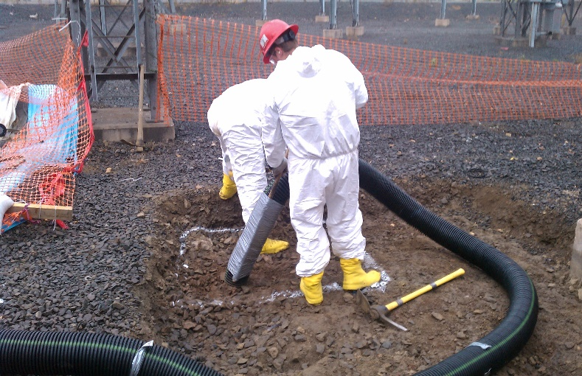
Typical Onsite Remediation Environmental Safety Precautions (cont’d)
Enclose work area perimeter with silt fence and staked hay bales
Construct decontamination area for all vehicles from the work zone leaving site
Containerize decontamination wash water & liquids and dispose properly
Use of water sprays/mist for dust control
Wastes from the work placed in covered/sealed roll-off containers inside a lined and secure fenced area
Materials and personnel in the work zone decontaminated before leaving site
Ambient air monitoring within and around the work zone performed
Trained remedial workers and oversight personnel
Ongoing evaluation of work areas as well as means and methods to ensure against contaminant release

Slide 15
Keeping you informed
The English Station Remediation Project website will continue to be updated regularly as new information becomes available.
An informational web page is available at www.uinet.com/englishstation
For additional inquiries, please call UI’s Public Outreach Office
  (888) 848-3697

Slide 16

Questions

