Slide 1
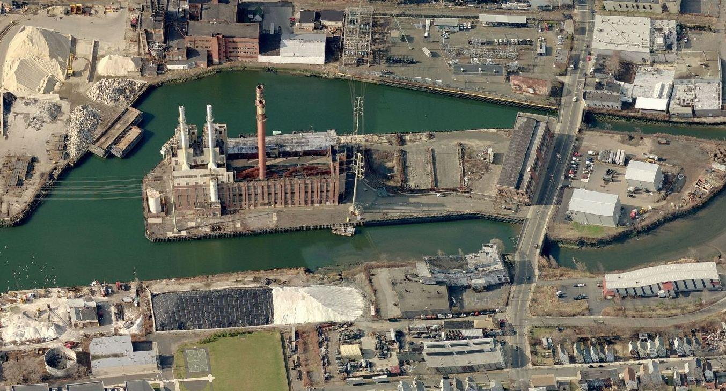

English Station
Remediation Update
June 22, 2017

Slide 2
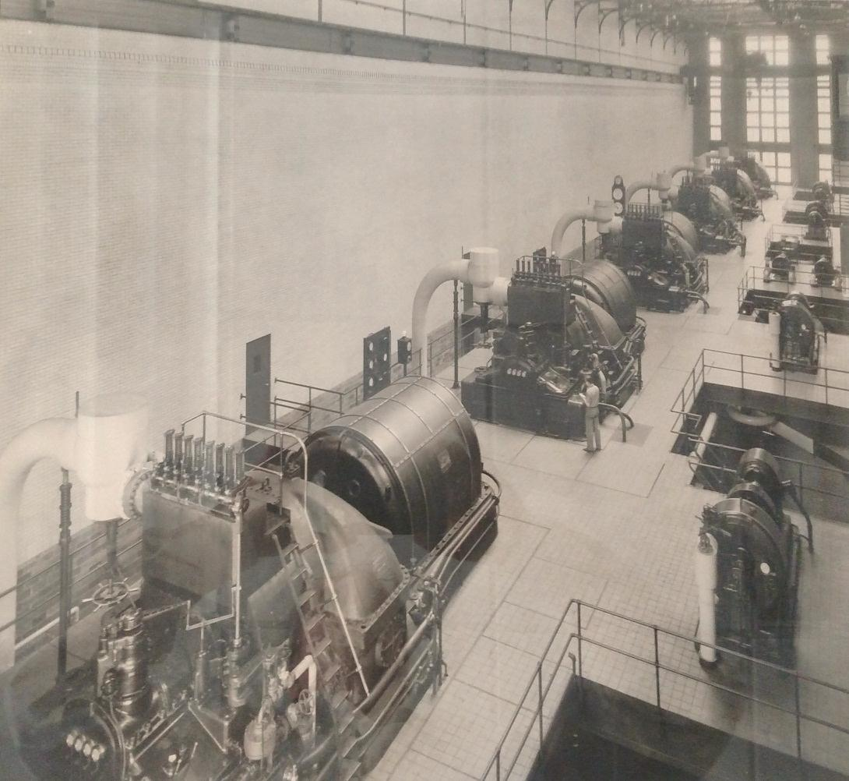
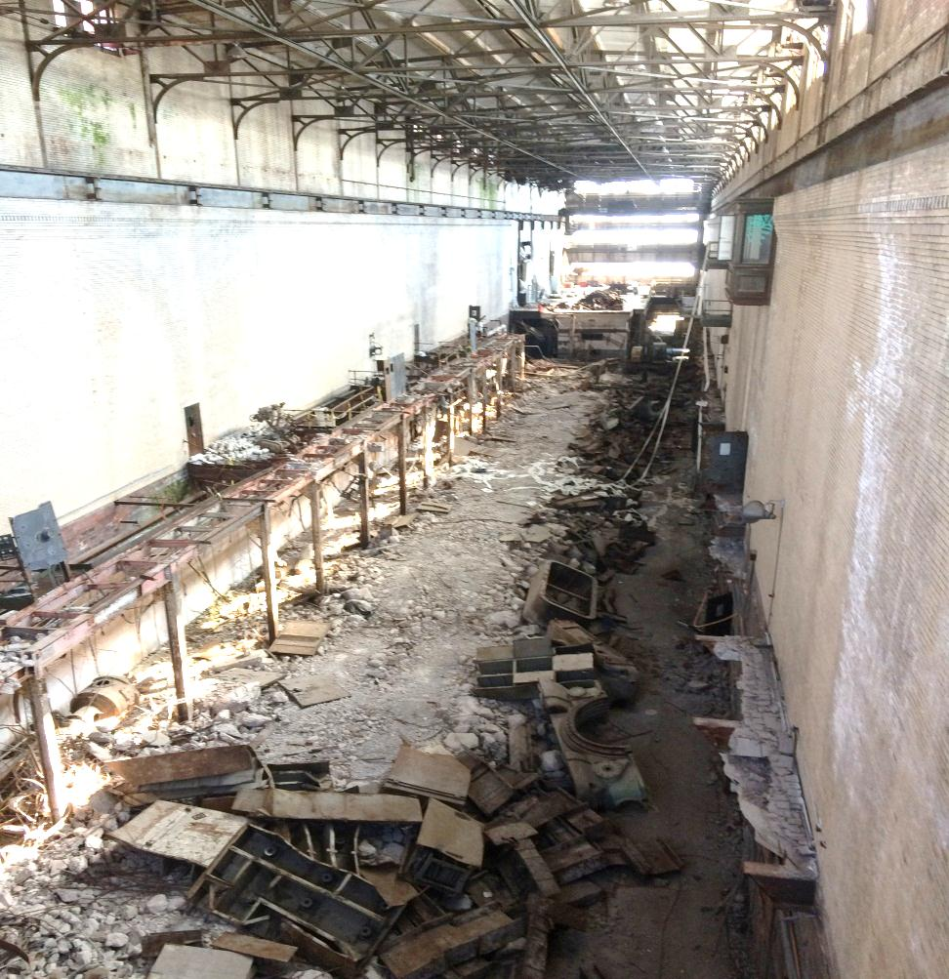
Introduction
1950’s
2017

Slide 3
Agenda
Background and History
Project Activities
  Investigation
  Remediation
Schedule
Remediation Requirements
Site Safety Precautions
  Building Abatement
  Site Remediation
Keeping You Informed

Slide 4
Background
Station B
(Parcel A)
North
English Station
(Parcel B)
Grand Ave

Slide 5
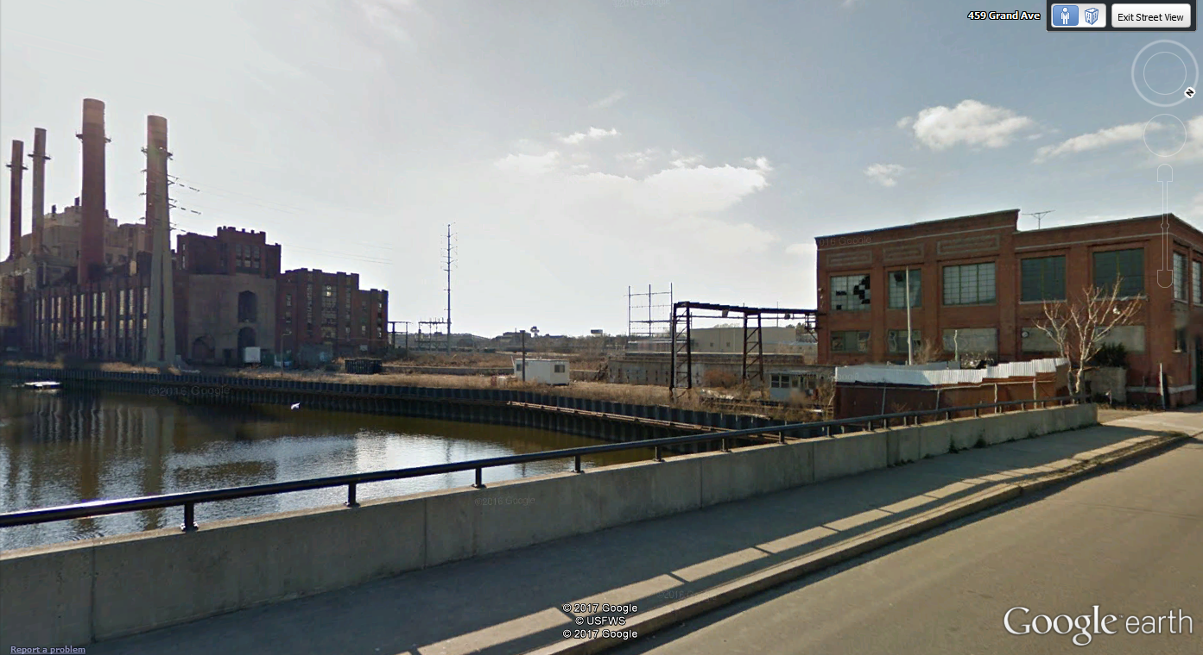
Background
English Station
Station B
Grand Ave

Slide 6
Background
The English Station Site is approximately 8.9 acres
The English Station building has a footprint of approximately 100,000 square feet
The Station B building has a footprint of approximately 25,000 square feet
History
1890 – Station B provides electricity to Greater New Haven
1929 – English Station begins operation as a coal-fired electric generating station
1958 – English Station is converted to oil-fired generation
1992 – English Station ceases operation
2000 – UI sells English Station to an unaffiliated party
2006 – Property subdivided, by then – current owner, 5.3 acre English Station Parcel sold to ASNAT Realty, 3.6 acre Station B parcel sold to Evergreen Realty
2015 – UI agrees to investigate and remediate the site
Background and History of the Site

Slide 7
Project Activities
Investigation Work
Building temporary roads to ensure that cross contamination of areas does not occur
Collecting soil borings (by hand and machine)
Collecting water samples
Installing monitoring wells
Performing investigations in English Station and Station B to identify the type, quantity and location of all asbestos, non-hazardous and hazardous waste

Slide 8
Project Activities
Remediation Work
Removal and disposal of contaminated debris
Excavation, loading and transport of contaminated soil (to be replaced with suitable fill material)
Ground water treatment and disposal
Concrete slab remediation
Removal and transport of hazardous building materials
Abatement and disposal of asbestos and asbestos containing material
Disposal of water used in remediation and/or abatement efforts

Slide 9
Remediation Requirements
Remediation Requirements are described in Partial Consent Order (PCO) AOWSPCB 13-001 issued by CT-DEEP, and consented to by UI.
  Soil and Groundwater – Commercial/Industrial Standard
  Buildings – High Occupancy Standard
Connecticut’s Remediation Standard Regulation (RSR’s)

Slide 10
Project Schedule
Current Approved Work Schedule:

Slide 11
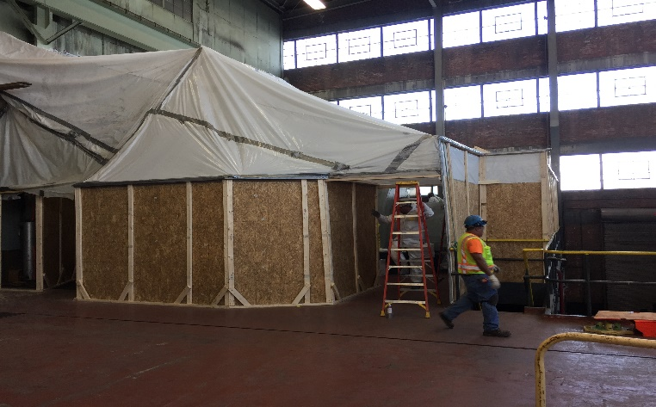
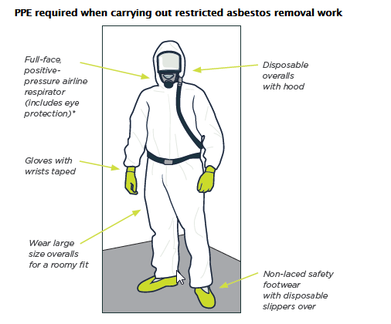
Building Abatement Environmental Safety Precautions
Sealed poly containments established to completely enclose work area
HEPA filtered negative air to be used in containments to prevent airborne releases
Negative air pressure monitored continuously
Air sampled periodically outside containments to ensure no release of asbestos
All wastes placed in sealed double bags/boxes before leaving containment and placed in secure trailers
All materials and personnel leaving containment decontaminated
Wash water will be collected and contained at lower elevations inside containment areas
Licensed asbestos monitors will provide ongoing evaluation of work areas as well as means and methods to insure against a contamination release.
Typical Containment

Slide 12
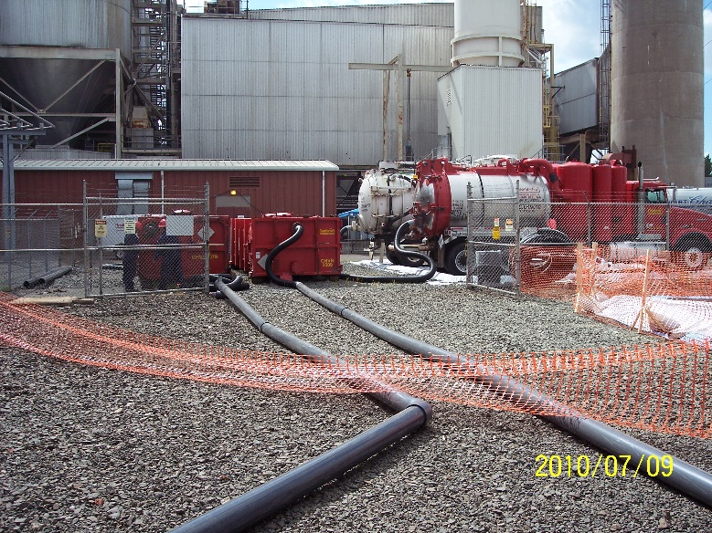
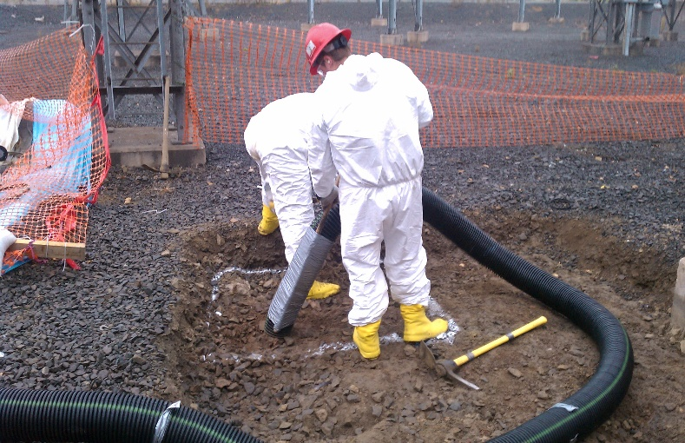
Site Remediation Environmental Safety Precautions
Enclose site perimeter with silt fence and staked hay bales
Construct decontamination area for all vehicles leaving site
Containerize all decontamination wash water & liquids
Liberal site-wide use of water sprays/mist for dust control
All wastes placed in covered/sealed roll-off containers inside a lined and security fenced area.
All materials and personnel leave site decontaminated
Ambient air monitoring to ensure controls are effective
Trained remedial inspectors will provide ongoing evaluation of work areas as well as means and methods to insure against a contamination release.
Typical Waste Storage Area
PCB Remediation

Slide 13
Keeping you informed
The Company will be keeping abutters informed about the status of the project through our Public Outreach Department.
Project Notification Letters will be sent to abutters via USPS as appropriate
Many of you here today received the first notification letter advising of this meeting
An informational web page will be available at UINET.COM
For additional inquiries, please call UI’s Public Outreach Office
  (888)-848-3697

Slide 14

Questions

